Slide 1



2451i group
Database
Shipping Database
Course Project

Slide 2
2451i group
Database
Shipping Database
Course Project

Slide 3
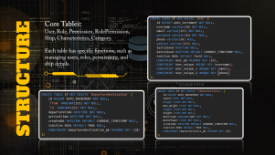
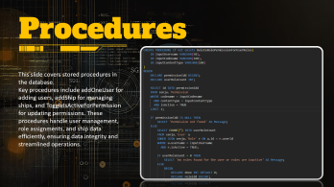
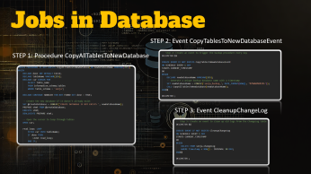

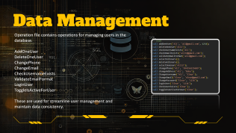
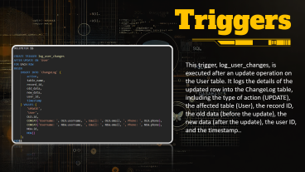
STUDIO SHODWE
TEHCNOLOGY
PRESENTATION
RoadMap of this Project
27 JUNE, 2024

Slide 4

INTRODUCTION
This project involves the design and implementation of the Shipping database, which serves as the backbone for managing users, roles, permissions, ships, and related operations. It demonstrates advanced SQL techniques including the use of stored procedures, relationships, and data validation.

Slide 5
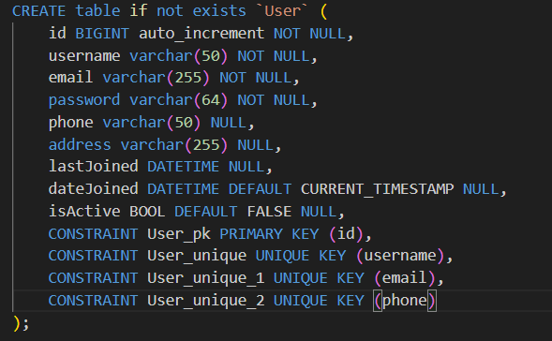
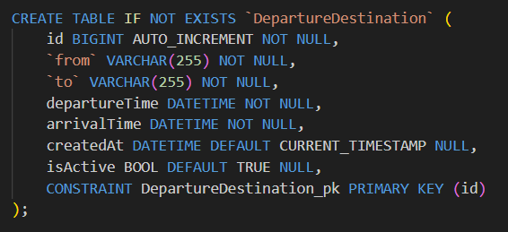
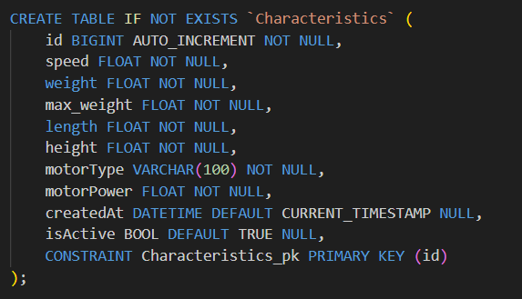
Core Tables: User, Role, Permission, RolePermission, Ship, Characteristics, Category.
Each table has specific functions, such as managing users, roles, permissions, and ship details.
STRUCTURE

Slide 6
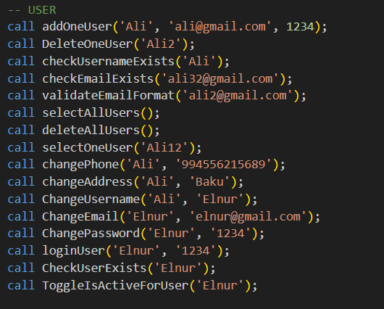
Data Management
Operation file contains operations for managing users in the database.
AddOneUser
DeleteOneUser
ChangePhone
ChangeEmail
CheckUsernameExists
ValidateEmailFormat
LoginUser
ToggleIsActiveForUser
These are used for streamline user management and maintain data consistency.

Slide 7
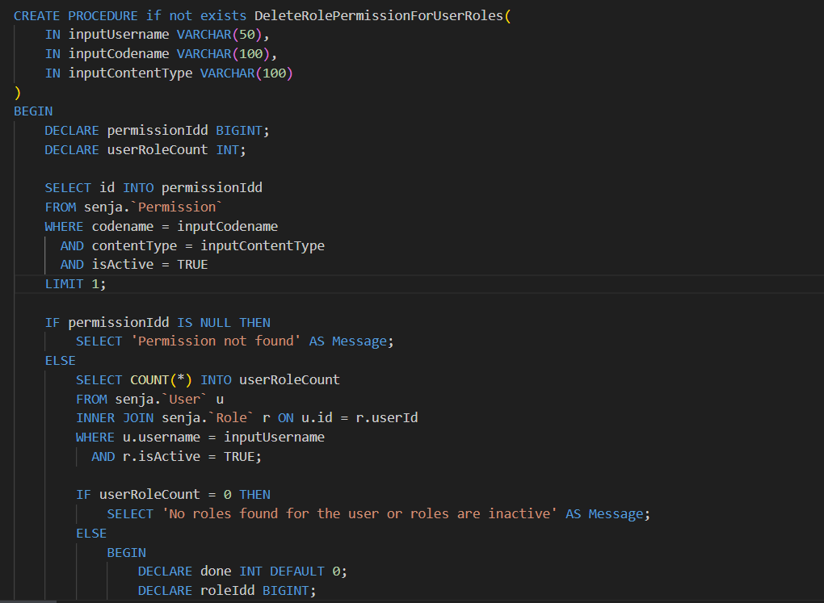
Procedures
This slide covers stored procedures in the database.
Key procedures include addOneUser for adding users, addShip for managing ships, and ToggleIsActiveForPermission for updating permissions. These procedures handle user management, role assignments, and ship data efficiently, ensuring data integrity and streamlined operations.

Slide 8
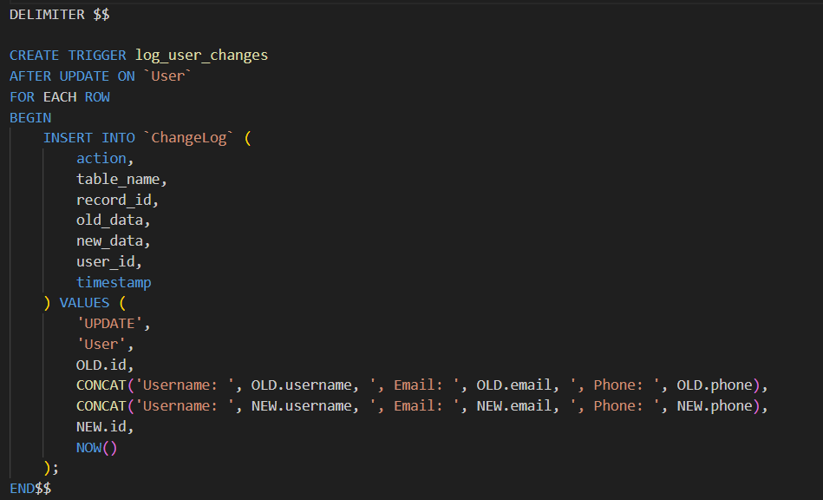
Triggers
This trigger, log_user_changes, is executed after an update operation on the User table. It logs the details of the updated row into the ChangeLog table, including the type of action (UPDATE), the affected table (User), the record ID, the old data (before the update), the new data (after the update), the user ID, and the timestamp..

Slide 9

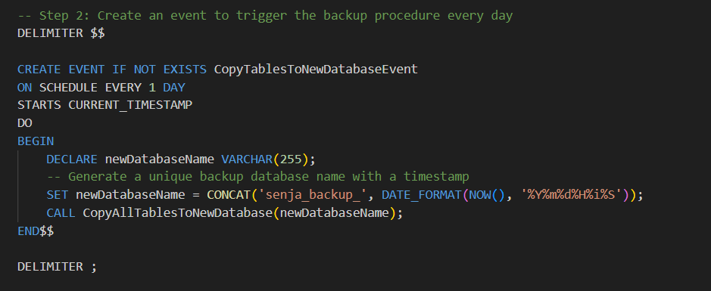

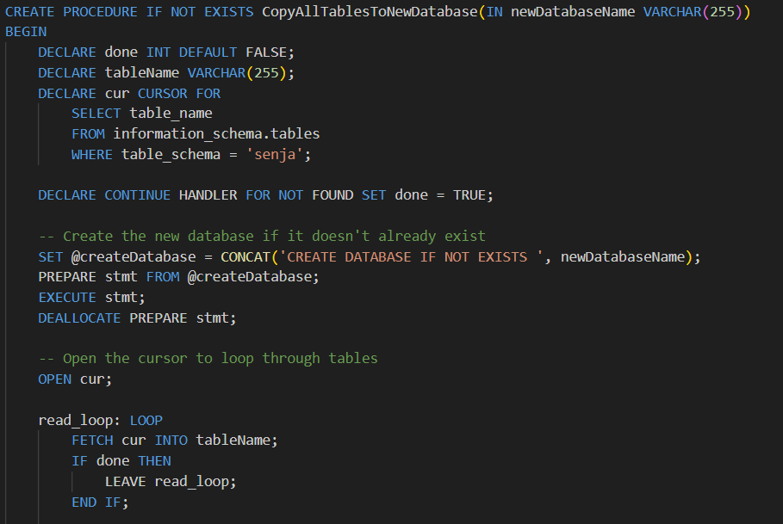

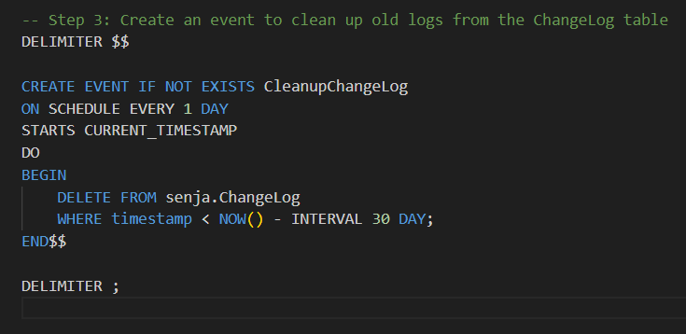
OUR TEAM
Jobs in Database
STEP 2: Event CopyTablesToNewDatabaseEvent
STEP 1: Procedure CopyAllTablesToNewDatabase
AMAL MIRZAYEV
STEP 3: Event CleanupChangeLog
ELNUR HUSEYNOV

Slide 10
2451i
OUR TEAM
AMAL MIRZAYEV
ELNUR HUSEYNOV
Course Project

Slide 11
2451i
THANK YOU
Course Project

